Slide 1

Car safety
Instructor: Dr. Marek Perkowski
Team members: Amulya Huchachar
Aniruddha shahapurkar

Slide 2
overview
Components:
1 DC motor
3 Servo motors
Raspberry Pi3
Raspberry Pi Camera
2 RGB LEDs
Features
Movement(Forward, Backward, Right, Left)
Image detection
Obstacle avoidance
LED indicators

Slide 3
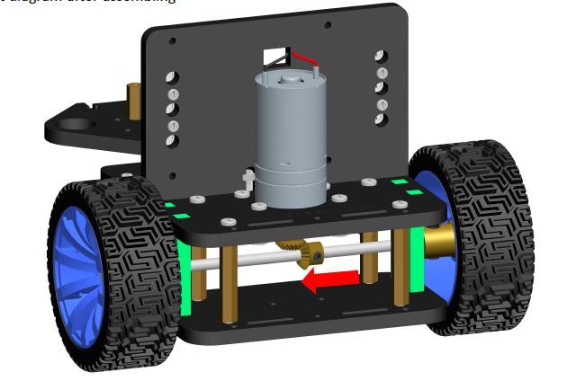
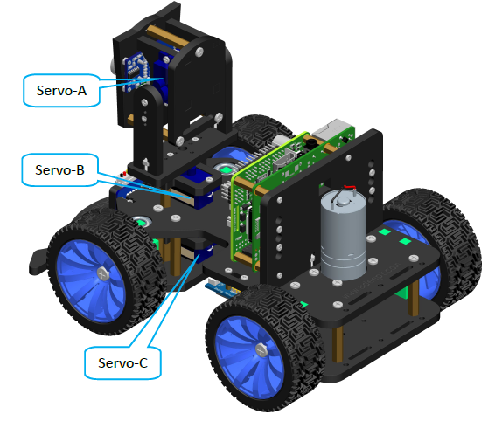
Motion control mechanism
DC Motor control
Servo Motor control

Slide 4
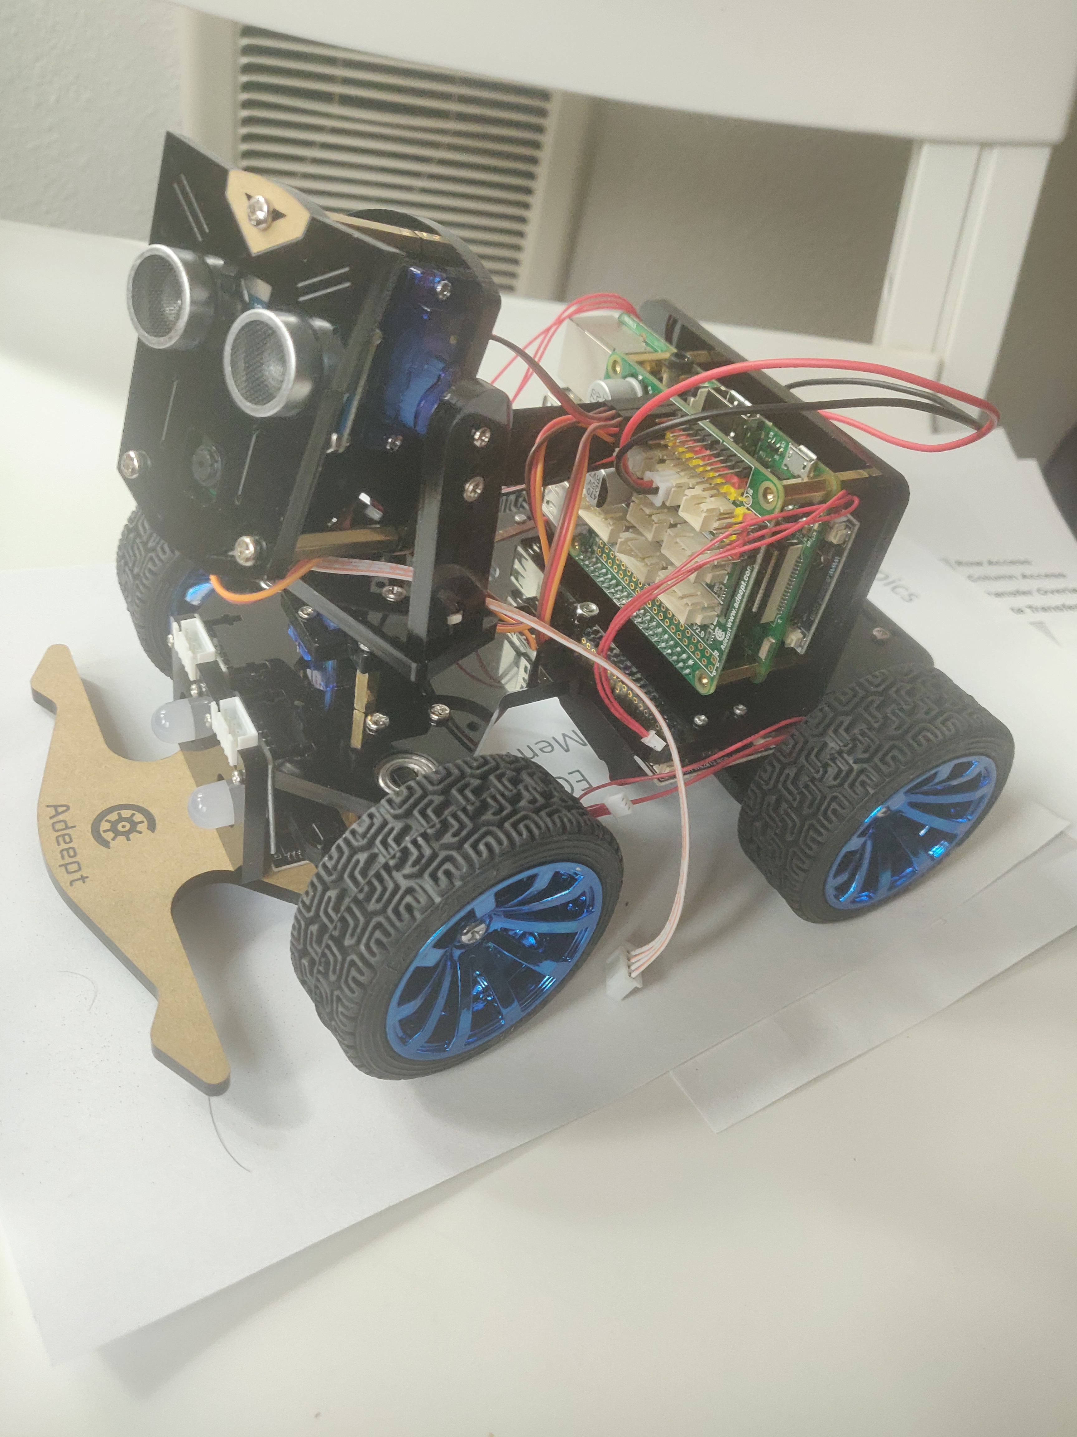
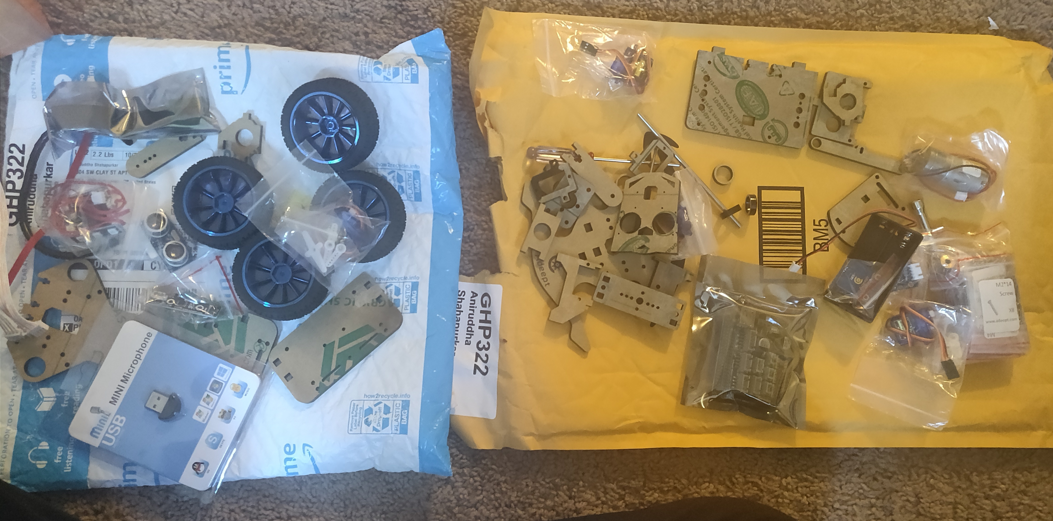
Assembly
Before Assembling
After Assembling

Slide 5
Software tools
Python
OpenCV
NumPy

Slide 6
Vehicle motion and led control
Controlled all the three servo motors
Controlled DC motor for car’s forward and backward movement.
Controlled the two RGB LEDs.

Slide 7
Object detection
Successfully detected a yellow ball using OpenCV and Picamera.

Slide 8
Obstacle avoidance
When the object was detected at a closer distance with the car, the car took right turn to avoid the obstacle.

Slide 9
Challenges faced
Built the robot from the scratch and software installation took time.
Finding 18650 batteries.
Implementation of color masks using OpenCV

Slide 10
Possible improvements
Building a better platform for the car using various obstacles to check the performance.
Implementation of plane to plane homography.
To convert the frames to a birds-eye-view.

Slide 11
conclusion
It was great learning experience till now, as we learnt motion control using DC and Servo motors and object detection via image processing where we explored OpenCV tool.

